Slide 1
ENKORE
ECO HEALTHCARE
  PROPELLING THE SHIFT TOWARD THE FUTURE OF CIRCULAR, SAFE AND SUSTAINABLE PACKAGING AND SINGLE USE DEVICE ECODESIGNED SOLUTIONS THROUGH HEALTHCARE ENVIRONMENTS.

Slide 2





ENKORE
Propelling the shift toward the future of circular, safe and sustainable packaging and single use device ecoDesigned solutions through healthcare environments.
Topic:
HORIZON-JU-IHI-2023-04-05 / Safe & Sustainable by Design (SSbD) packaging and single use device solutions for healthcare products.
Type of action: HORIZON-JU-RIA HORIZON JU Research and Innovation Actions
Duration:
48 months.
The project runs from 1 January 2025 to 31 December 2028.
36 partners from 10 EU countries, Switzerland, Bosnia and Herzegovina, and USA.
15 Associate partners from Switzerland, United Kingdom, Ireland, Germany, and Italy.
Total budget: 19,6 ME
(7,7 € ME EU Funding + 9,9 ME € Industry contribution + 2 ME € associated countries partners)

Slide 3
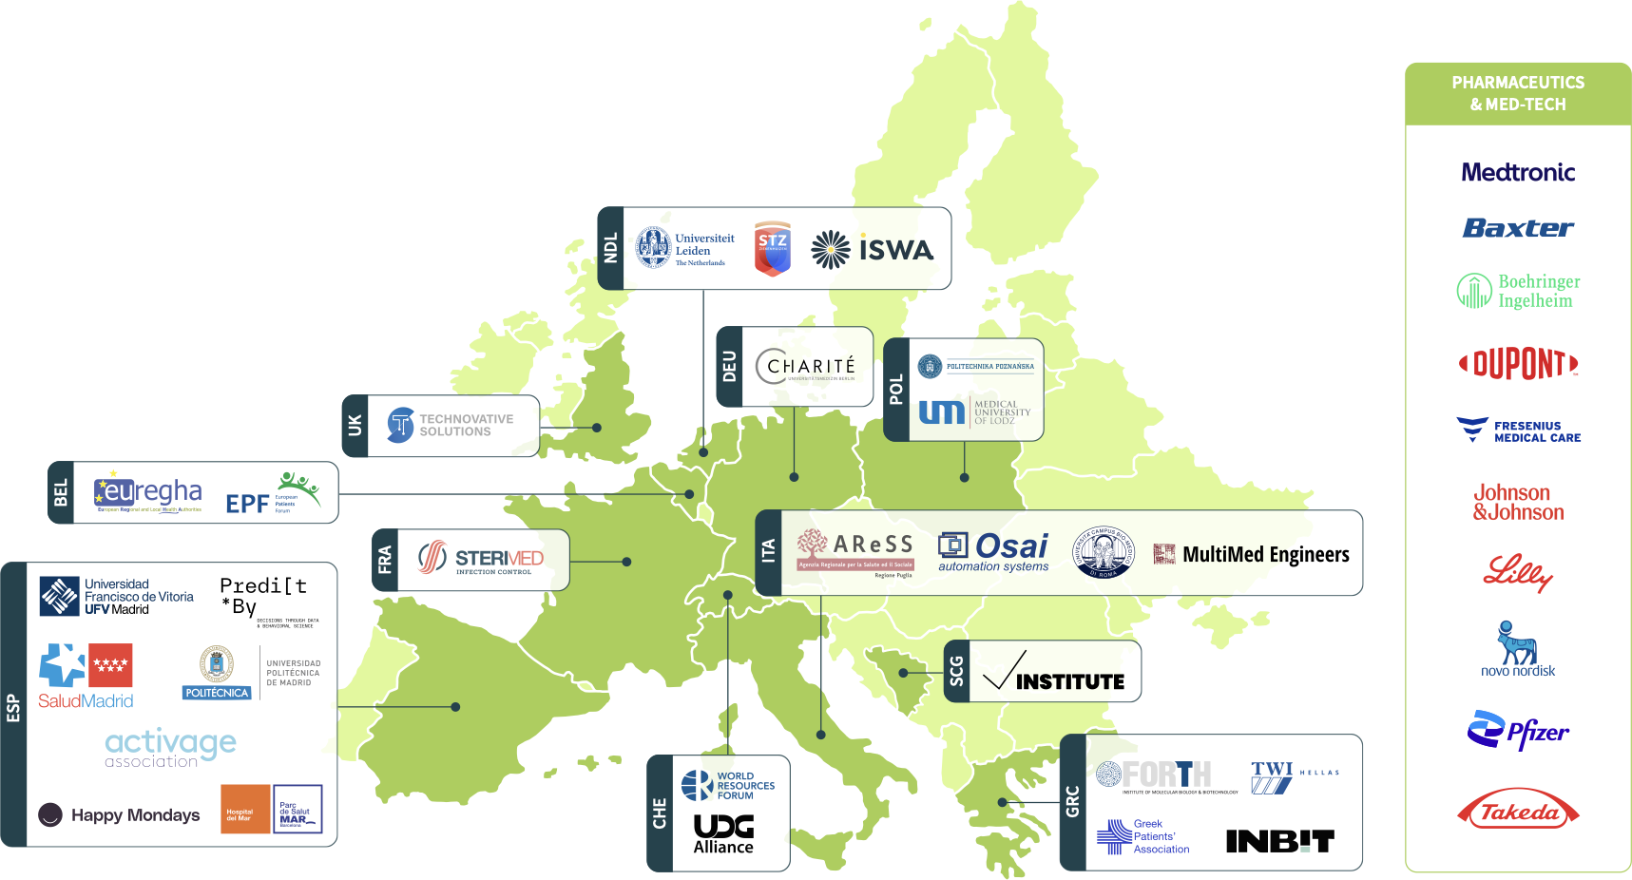
CONSORTIUM

Slide 4




MAIN GOAL
ACCELERATING INNOVATION THROUGH ECODESIGN
Vision: ENKORE aims to drive accelerated innovation by establishing an ecoDesign framework that is circular, safe & sustainable by design (SSbD). Inspired by the SSbD framework, it supports the development of environmentally responsible patient solutions while reducing environmental impact and carbon footprint.
Holistic Product Lifecycle Approach: From materials selection and product design to end-of-life, ENKORE enables the creation of circular packaging and single-use medical devices while ensuring patient safety and regulatory compliance.
Methods & Tools for Decision-Making:
✔ Environmental & Social Life Cycle Assessment (ELCA/SLCA)
✔ Circularity Calculator (CC)
✔ Digital Product Passport (DPP)
By fostering closed-loop systems and leveraging advanced data, technologies, and best practices, ENKORE ensures safer, greener, and more efficient healthcare solutions for the future.

Slide 5











ENKORE CONCEPT
ECO DESIGN
FRAMEWORK
(CIRCULAR AND SAFE
& SUSTAINABLE BY
DESIGN - SSBD)
PRODUCT / PACKAGE DEVELOPMENT
CORE REQUERIMENTS
END OF LIFE, RECYCLING &
CIRCULARITY REQUIREMENTS
Resources
Usage
Product Information
Recyclability
Restrictions for recycling
Requirements
(e.g. sophisticated package)
Collection
Sortability
Education & Incentives
(Communication & Marketing)
KEMs
KESS
METHODS & TOOLS
DIGITAL PRODUCT PASSPORT (DPP)
ENVIROMENTAL AND SOCIAL LIFE CYCLE
ASSESSMENT (ELCA/SCLA)
CIRCULAR CALCULATOR

Slide 6




OBJECTIVES
CATEGORISED INTO PHASES
Conceptualising
Modelling
Implementing
Testing & validating
Outreaching & disseminating
Conceptualising
Modelling
1. Evidence Mapping & Synthesis
2. Capture Stakeholder Requirements for Real-World Use Cases.
3. Create a Catalogue of Key Enabling Materials (KEM) & Sustainable Solutions (KES)
4. Develop an ecoDesign Framework for Packaging & Devices
Conduct downstream research to evaluate current and emerging circular materials for packaging and devices.
Explore upstream circularity frameworks to understand their impact on cost-benefit analysis, patient satisfaction, and safety.
Gather insights from regulators, industry, healthcare providers, and patients.
Define and federate Reference Use Cases (RUCs) for testing and implementation.
Identify essential materials and circular solutions for packaging and medical devices.
Facilitate pathways from KEM to KES and vice versa to promote material circularity.
Support the development of eco-responsible packaging and single-use devices.
Enable a closed-loop system ensuring sustainability from design to disposal.

Slide 7





OBJECTIVES
CATEGORISED INTO PHASES
Conceptualising
Modelling
Implementing
Testing & validating
Outreaching & disseminating
Implementing
Testing & validating
Outreaching & disseminating
5. Validate the Framework Through Real-World Implementation
6️. Provide Digital Tools for Circularity Assessment
7. Accelerate the Transition to Circular & Sustainable Solutions
8. Influence Standards & Regulatory Frameworks
9. Raise Awareness & Drive Cultural Change
Test and validate the ecoDesign framework across Reference Use Cases (RUCs).
Collect tangible evidence to ensure scalability and adoption in healthcare.
Develop and implement a Digital Product Passport (DPP) for medical packaging and devices.
Equip designers, manufacturers, and healthcare professionals with decision-support tools.
Promote the adoption of circular, SSbD-based packaging and medical devices.
Engage industry stakeholders to facilitate a sustainable shift in HealthTech.
Collaborate with regulators and standardization bodies to align with SSbD principles.
Ensure acceptability and practical implementation of sustainable regulations.
Increase awareness among regulators, healthcare professionals (HCPs), patient associations, and the public.
Foster education and engagement on the lifecycle impact of medical packaging and devices.

Slide 8


ENKORE WORK PACKAGE (WP) OPERATIONAL FLOW
Project Pillars / Foundations for WPs
Generation of WP’s inputs
(M1-M30)
WPs Implementation
Generation of WP’s inputs
(M6 & M12)
RUCs demonstration
Functional & technical integration for
validation (M18)
WP1: Meta-assessment, evidence identification, exchange of knowledge and requirements
RUCs ` flows & Paths
Functionalities & Planning
WP2: ENKORE ecoDesign
FRAMEWORK
Planning & Implementation
WP4: Reference Use Cases and Validation
(Monitoring & Planning)
Info 4 Materials
& LCA (KEM & KES)
Framework
Info 4 Tech requirements
Framework
WP7: Project Coordination, Administration and management
Review of current information & evidences
(other UCs, KES, approaches, etc)
Mapping of information & Evidences
Mapping of requirements (functional / Processes)
Planning and Characterization of Use Cases
(information flow)
Planning of Workshops for WP3 & WP4
WP3: ENKORE Suite of Services
Supporting infrastructure
Activity implementation
Showcasing,
Adoption, Ecosystem &
Sustainability
Results & evidences
Activity implementation
Results & evidences
Activity implementation
Engagement
& Elicitation
Validation & Engagement
Results & evidences
WP6: Communication, dissemination and results exploitation and sustainability (organisation of Workshops WP3 & WP4, visualization/ D&C of content from activities)
WP5: Outreach, engagement, best practices and lessons learnt (Liasson & Engagement of stakeholders)

Slide 9





REFERENCE USE CASES
RUCS
1
2
3
4
5
Drug injection devices
Single use products for dialysis, intravenous, nutrition and irrigation therapies
Sustainable plastic material for packaging
Sustainable cellulose material for packaging
To scale the recycling of healthcare related medical devices and packaging after use in the hospital setting

Slide 10
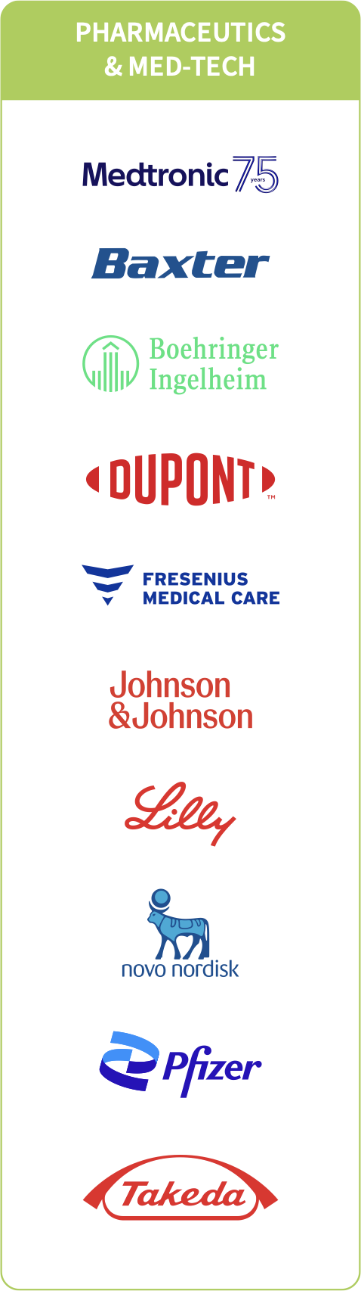



REFERENCE USE CASES
Single Usage Devices
Single Usage Devices (SUD)
1
2
5
Drug injection devices
Single use products for dialysis, intravenous, nutrition and irrigation therapies
To scale the recycling of healthcare related medical devices and packaging after use in the hospital setting

Slide 11


REFERENCE USE CASES
Packaging
Packaging
3
4
Sustainable plastic material for packaging
Sustainable cellulose material for packaging

Slide 12


















REFERENCE USE CASES
Assesment framework
High level (Strategic/processes)
Treated Patient
R&D
PRODUCTION
DISTRIBUTION
USAGE
WASTE PROCESING
Prescriber Clinician
Return
Hospital
Chemical waste
Excrete
Pharmacy
R&D
Manufacturer
Wholesale
RWZI
Improper disposal
Patient
Chemistry
Throw away
Combustion

Slide 13



REFERENCE USE CASES
Assesment framework
Operative Level (Product) - Low level (tangibly validates high level in circuits)
Environmental & Regulatory information & Processes Input
DESIGN R&D
PRODUCTION
DISTRIBUTION
USAGE
WASTE PROCESING
Prescriber Clinician
Return
Hospital
Chemical waste
Excrete
R&D
Manufacturer
Wholesale
Pharmacy
Improper disposal
RWZI
+ EU &
Local Context
Chemistry
Patient
Throw away
Combustion
Waste Processess & Information Outpu EWC
Tool Reviews
Case Studies
Frameworks
Conceptualizing (Mapping) & Modelling
Implementing & Testing
Validating and Recommendations (SSbD & Regulations)

Slide 14
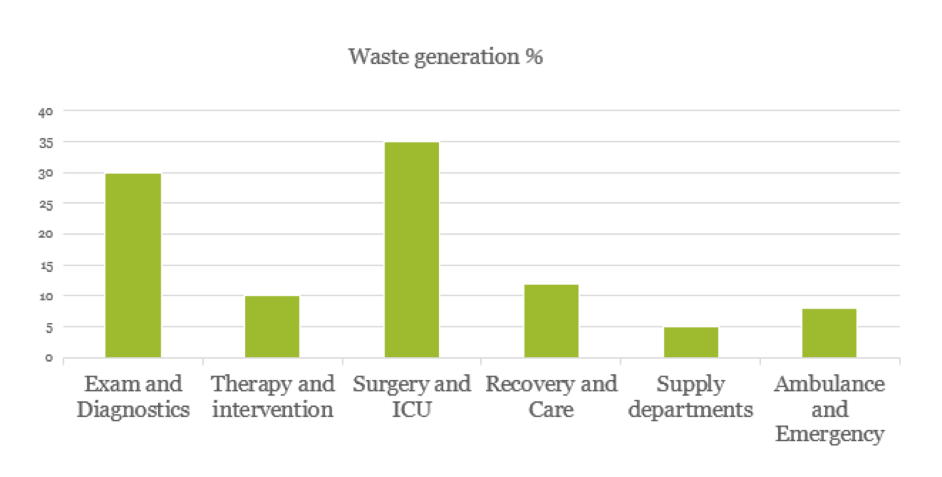

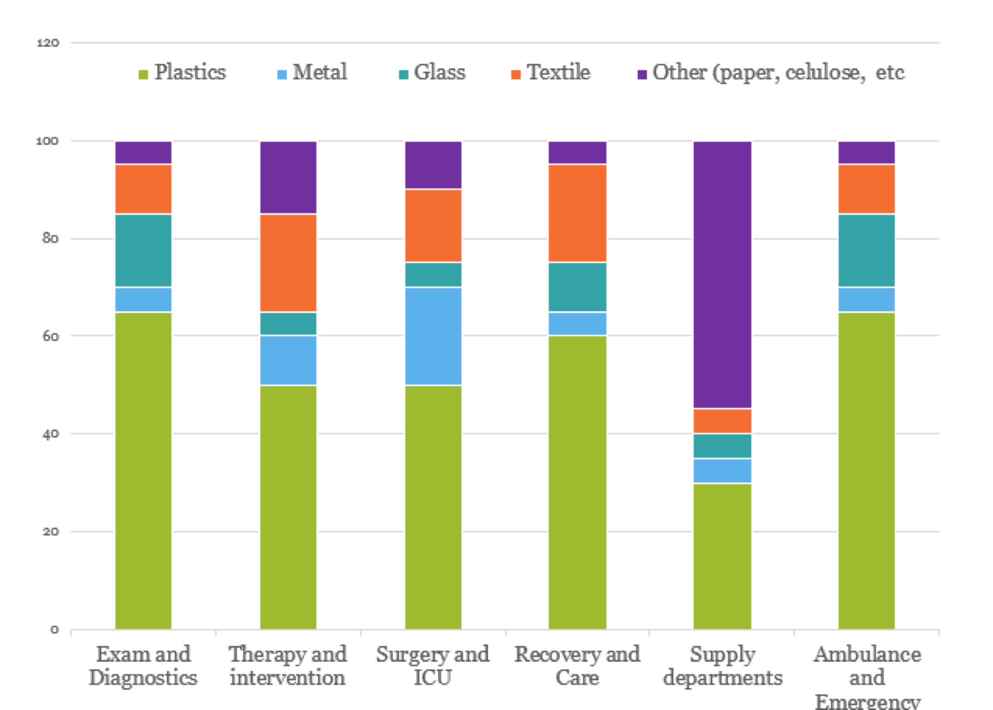
REFERENCE USE CASES
Patients Circuits / Pathways
Hospital Circuits / Pathways
EXAMINATIONS & DIAGNOSTICS
THERAPY & INTERVENTION
SURGERY
& ICU
HOSPITALS
AMBULANCE & EMERGENCY
RECOVERY
& CARE
PROCUREMENT DEPARTMENTS

Slide 15


REFERENCE USE CASES
Assesment framework
High level (Strategic/processes)
Environmental data input
Patient
Waste Output EWC
Manpower
Effluent & Emissions
Energy & Water
Uso, waste processing, R&D, manufacturing
Chemical & Pharmaceutical Waste
Pharmaceuticals & Chemicals
DESIGN R&D
PRODUCTION
DISTRIBUTION
USAGE
WASTE PROCESING
Cytotoxic Waste
Hospital
Prescriber Clinician
Return
Chemical waste
SUD’s; Syringes
Excrete
Infectious Waste
Pharmacy
Single Usage
Devices (SUD)
Disposables: Dressings, Swabs etc
R&D
Manufacturer
Wholesale
Improper disposal
RWZI
Chemistry
Patient
Sharp Waste
Throw away
Combustion
Needles, Scalpels etc
Patho-Anatomical Waste
Non medical items
Communal Waste
Treated Patient
Recyclables WEEE

Slide 16

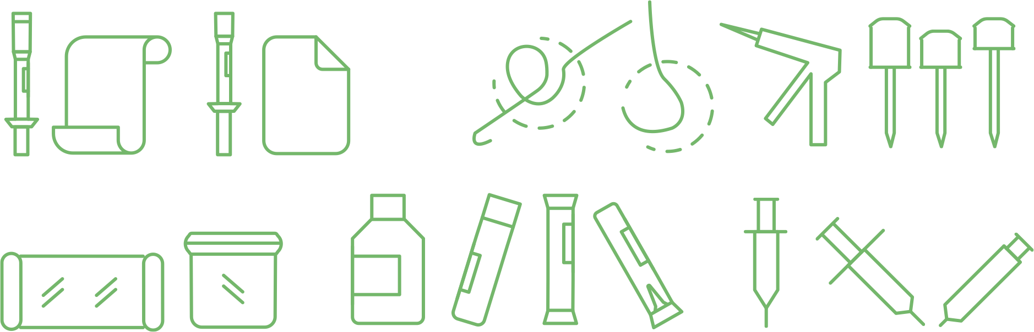


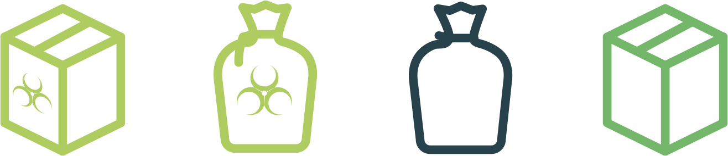



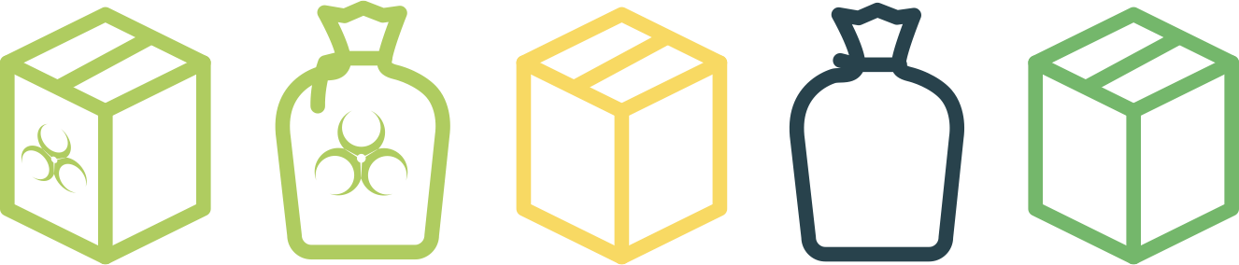
SSBD DRIVEN ECODESIGN
Example of surgical procedure
SSbD driven EcoDesign Framework
SURGICAL SET UP
LAPAROSCOPIC APPENDECTOMY
1
SOCIAL
DIMENSION
3
REGULATORY DIMENSION
5
TODAY’S outputs
SHARPS
Infectious
waste
Household
waste
Packaging
waste
2
4
FUTURE outputs
HAZZARD /SAFE DIMENSION
ENVIRONMENT DIMENSION
TECHNO-ECONOMIC DIMENSION
SHARPS
Infectious
waste
MATERIAL
RECOVERY
Household
waste
Packaging
waste

Slide 17

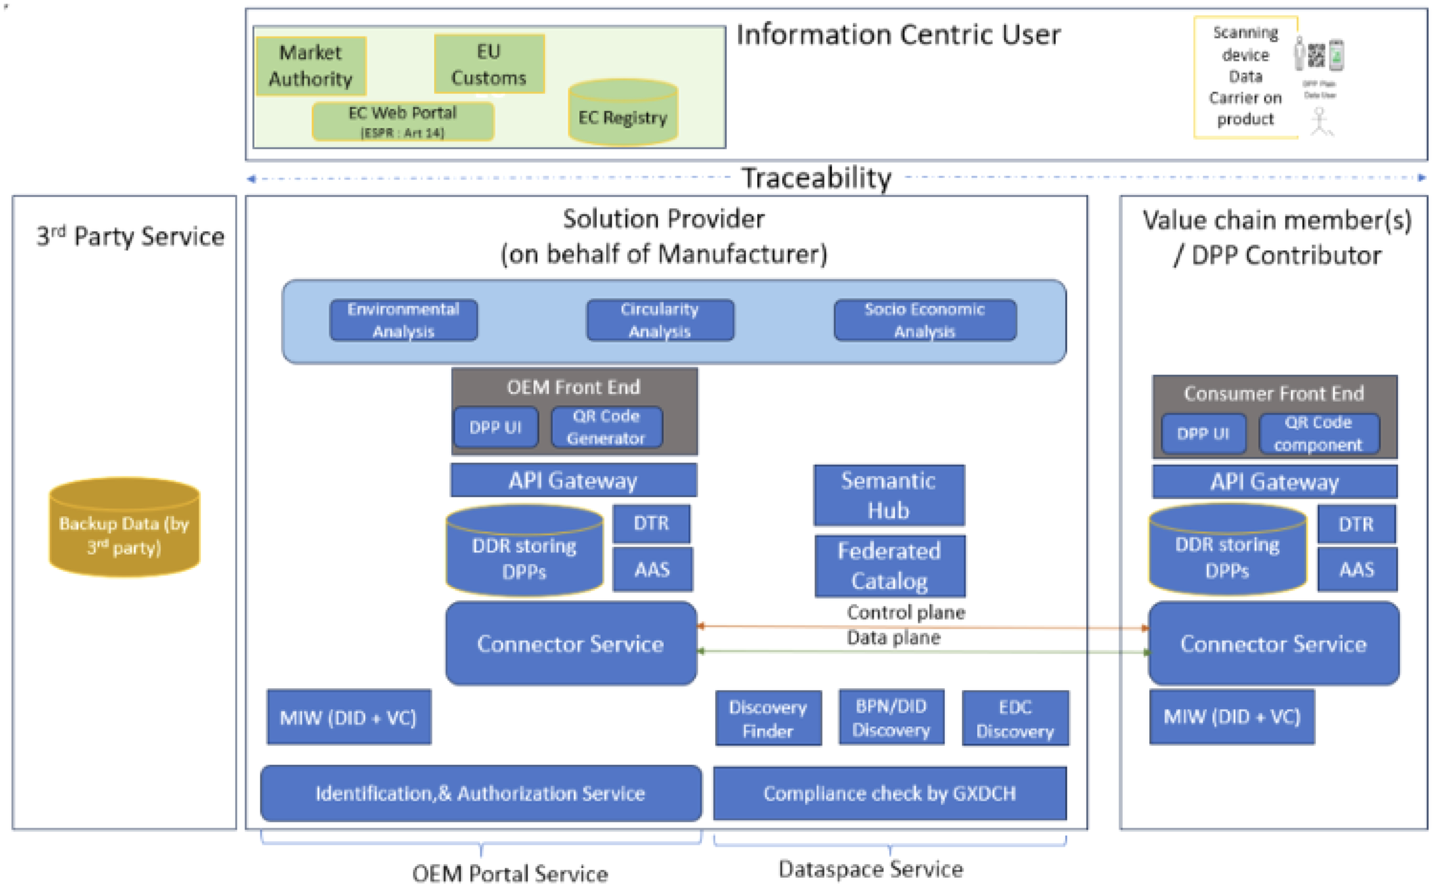





ENKORE enhanced circularity
Integrate LCA/S-LCA and cost model based on KEMs and KESes.
Visualization of circularity calculator tool: capturing retained values.
Enable a simple DPPs (digital product passports) for proposed products enable and link results under traceability perspective.
Link with DB and catalogue of regulations
Waste & Emission
Leakage Avoidance
DESIGN
(RESOURCES)
Medtech Industry
Transportation
Hospital
Patients
Waste
EXTRACTED
RESOURCES
MANUFACTURING
DISTRIBUTION
USE
DISPOSAL
INCINERATION
STERILIZATION
EXTERNAL REPROCESSING
RECYCLE

Slide 18



KEY CONTRIBUTIONS
1
2
3
4
5
Impact 1: Strengthening European healthcare industry
  Evidence-based short circuit models at ENKORE RUCs.
  Circular approaches in packaging & medical devices.
Impact 2: Integrating Safe & Sustainable by Design (SSbD)
  RUCs integrate SSbD principles with ELCA/SLCA tracking.
  Systemic change with waste recycling & material tracking.
Impact 3: Driving research & best practices
  Lessons learned from ENKORE RUCs feed into guidelines.
  Framework feedback loop for continuous improvement.
Impact 4: Alignment with the European Green Deal
  Healthcare adopts sustainability metrics in decision-making.
  Evidence-driven goal alignment with EU net-zero strategy.
Impact 5: Enabling open & closed-loop circularity
  KEMs support material recycling & eco-friendly product design.
  KES fosters new materials (e.g., biobased polymers) for circular adoption.

Slide 19



CONTACT INFORMATION
Thank you!
GET IN TOUCH
ENKORE web: www.enkoreecohealthcare.eu
IHI fact-sheet: https://www.ihi.europa.eu/projects-results/project-factsheets/enkore
Follow us on LinkedIn: https://www.linkedin.com/company/enkore-ecohealthcare/
Follow us on BlueSky: https://bsky.app/profile/enkoreihi.bsky.social
Follow us on You Tube: https://www.youtube.com/@ENKOREECOHEALTHCARE
Coordinator:
    Universidad Politécnica de Madrid, UPM
Industry leader:
    Medtronic, MDT
Project management & contact:
    enkore.pmo@lst.tfo.upm.es
This project is supported by the Innovative Health Initiative Joint Undertaking (IHI JU) under grant agreement No 101166707. The JU receives support from the European Union’s Horizon Europe research and innovation programme and COCIR, EFPIA, Europa Bío, MedTech Europe, and Vaccines Europe.
Funded by the European Union, the private members, and those contributing partners of the IHI JU. Views and opinions expressed are however those of the author(s) only and do not necessarily reflect those of the aforementioned parties. Neither of the aforementioned parties can be held responsible for them.

